Slide 1


Slide 2

Ensemble Learning
Concept of ensemble learning: classification
Some ensemble classification methods
Concept of ensemble learning: clustering
Some ensemble clustering methods

Slide 3
How to select a proper learner
In any application, we can use several learning models; different parameter settings affect the final performance.
The No Free Lunch Theorem: no single learning algorithm in any domains always induces the most accurate models.
Try many and choose the one with the best results.
  An efficient solution?

Slide 4
What is ensemble: the wisdom of crowds
Ensemble learning refers to a collection of methods that learn a target function by training a number of individual learners and combining their predictions.
For many tasks, we often seek second opinion before making a decision, sometimes many more
We consider decisions of multiple experts in our daily lives
Why not follow the same strategy in automated decision making?

Slide 5
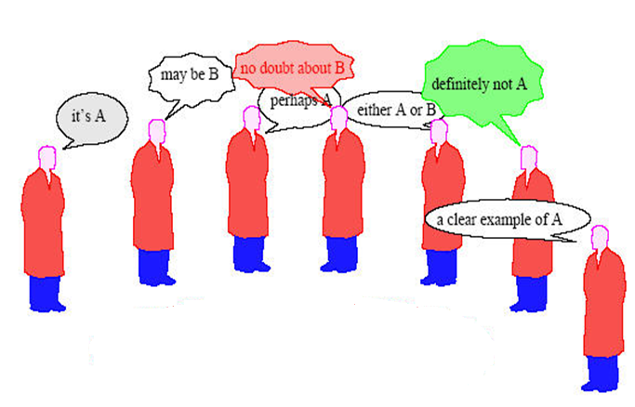
What is ensemble

Slide 6
Ensemble of classifier
class label
classifier
feature values
(object description)

Slide 7
Ensemble of classifier
class label
“combiner”
classifier
classifier
classifier
feature values
(object description)

Slide 8
How to Ensemble outputs?
Majority voting is the most popular method:
  give each base classifier equal weights (hard voting)
When some base classifiers are more trustworthy, then --
Soft voting should be made by giving them higher weights.
  using the cross-validation accuracy as the weights

Slide 9
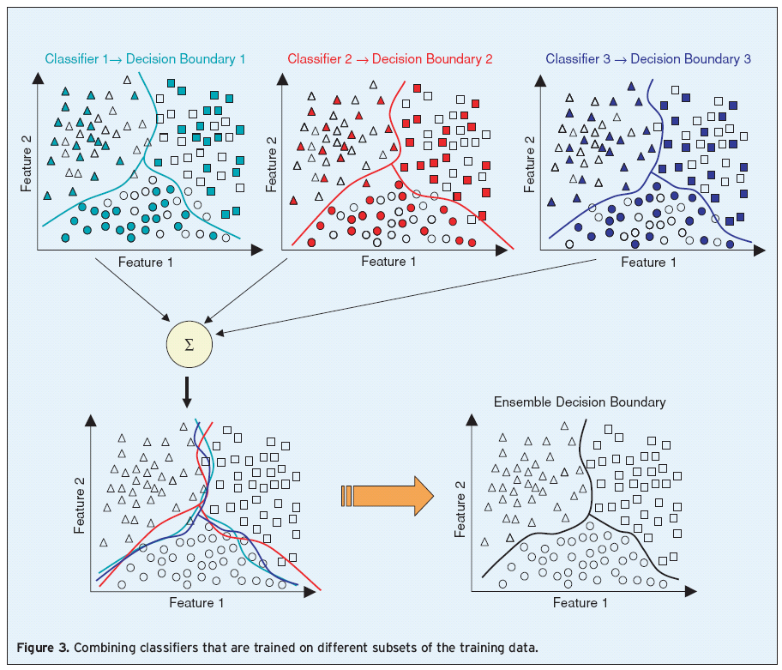
Why ensemble works

Slide 10
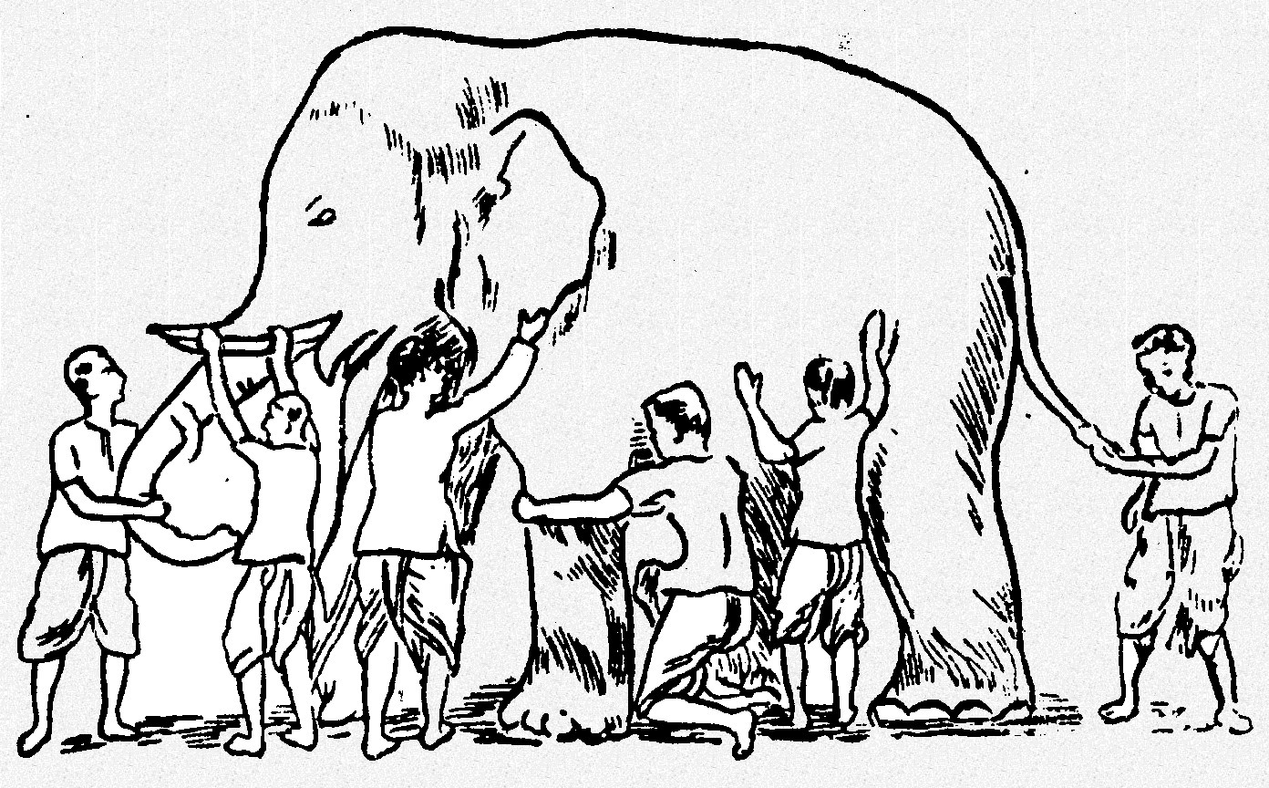
Why ensemble works
Some unknown distribution
Model 1
Model 3
Model 6
Model 5
Model 2
Model 4
Ensemble gives the global picture!

Slide 11
Why ensemble works
Accuracy: a more reliable mapping can be obtained by combining the output of multiple ”experts”
Efficiency: a complex problem can be decomposed into multiple sub-problems that are easier to understand and solve (divide-and-conquer approach).
Diversity: base classifiers make different mistakes, so that a wrong dicision can be corrected by others.

Slide 12
Why ensemble works
3 classifiers
individual accuracy = 10/15 = 0.667
Wrong Correct
ensemble accuracy (majority vote)
= 11/15 = 0.733
ensemble accuracy (majority vote)
= 10/15 = 0.667
Diversity is important and necessary

Slide 13
Why ensemble works
3 classifiers
individual accuracy = 10/15 = 0.667
ensemble accuracy (majority vote)
= 8/15 = 0.533
ensemble accuracy (majority vote)
= 15/15 = 1.000
Producing independent classifiers is important and necessary

Slide 14
Why ensemble works
3 classifiers
individual accuracy = 5/15 = 0.333
ensemble accuracy (majority vote)
= 0/15 = 0.000
Base classifiers should be accurate enough.

Slide 15
It works if
The base classifiers should be independent—making wrong decisions in different samples.
The base classifiers should do better than a classifier that performs random guessing. (error < 0.5)
In practice, it is hard to have base classifiers perfectly independent. Nevertheless, improvements have been observed in ensemble methods when they are slightly correlated.

Slide 16
How to ensemble classifiers
Subsampling the training examples
Manipulating the input features
Manipulating the output labels
Modifying the learning parameters of the classifier
Using heterogeneous models (not often used)

Slide 17
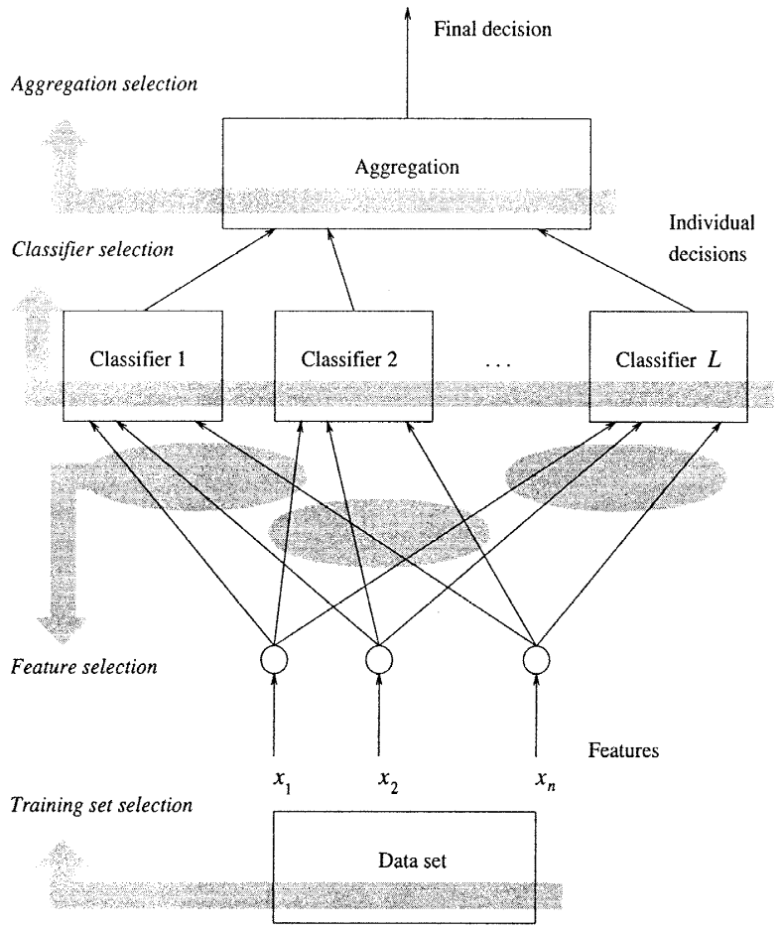
How to ensemble classifiers

Slide 18
Stories of success
Million-dollar prize
  Improve the baseline movie recommendation approach of Netflix by 10% in accuracy
Data mining competitions
  Classification problems
  Winning teams employ an ensemble of classifiers

Slide 19
Some famous ensemble classification methods
Bagging:
  Ramdon Forest
  Decision Forest
  Rotation Forest
Adboost
Other Frameworks

Slide 20
Bagging
Bagging: create classifiers using training sets that are bootstrapped (drawn with replacement)
  Build classifier on each bootstrap sample D
  D will contain approximately 63% of the original data.
Original | 1 | 2 | 3 | 4 | 5 | 6 | 7 | 8
Training set 1 | 2 | 7 | 8 | 3 | 7 | 6 | 3 | 1
Training set 2 | 7 | 8 | 5 | 6 | 4 | 2 | 7 | 1
Training set 3 | 3 | 6 | 2 | 7 | 5 | 6 | 2 | 2
Training set 4 | 4 | 5 | 1 | 4 | 6 | 4 | 3 | 8

Slide 21
Unstable classifier: DT; NN
Why? A slightly change in traning data can make the classifier change greatly
Bagging is a parallel algorithm.
“The vital element is the instability of the prediction method. If perturbing the learning set can cause significant changes in the predictor constructed, then bagging can improve accuracy.” (Breiman 1996)

Slide 22
Bagging-- some developments:
  Decision Forest：randomly select part of features;
  Random Forest：randomly select both samples and features;
  Rotation Forest：make a new sample by projecting the original to a new subspace;

Slide 23
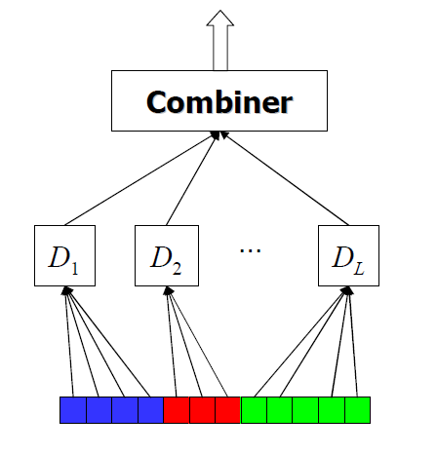
Random Forest
Random forest
  Randomly select records like bagging;
  Randomly select feature subsets;
  Using decision tree as base learner
  a lot of trees → a forest
Why tree???
  Decision tree is sensitive: slightly difference in training data can build a completely different tree.
  Neural network is also sensitive, but building a NN is time-consuming
  There are some other forests: decision forest, rotation forest.

Slide 24
Boosting (Schapire 1989)
Randomly select n₁ < n samples from D without replacement to obtain D₁
  Train weak learner C₁
Select n₂ < n samples from D with half of the samples misclassified by C₁ to obtain D₂
  Train weak learner C₂
Select all samples from D that C₁ and C₂ disagree on
  Train weak learner C₃
Final classifier is vote of weak learners

Slide 25
Some famous ensemble classification methods
Adaboost
  Sequential production of classifiers
  Each classifier is dependent on the previous one, and focuses on the previous one’s errors
  Why it works?
Training Samples
h₁(x)
Weighted Samples
h₂(x)
Sign[sum]
Weighted Samples
h₃(x)
Weighted Samples
h_{T}(x)

Slide 26
Instead of sampling, re-weight
  Previous weak learner has only 50% accuracy over new distribution
Can be used to learn weak classifiers
Final classification based on weighted vote of weak classifiers

Slide 27
Learner = Hypothesis = Classifier
Weak Learner: < 50% error over any distribution
Strong Classifier: thresholded linear combination of weak learner outputs

Slide 28
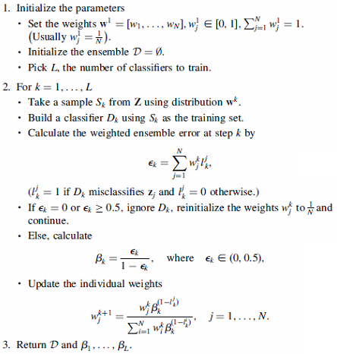
Training phase

Slide 29

Classification phase
http://videolectures.net/mlss05us_rudin_da/

Slide 30
Some famous ensemble classification methods
Adaboost
  Records that are wrongly classified will have their weights increased, therefore it is more likely to be chosen again in subsequent rounds
Original | 1 | 2 | 3 | 4 | 5 | 6 | 7 | 8
Training set 1 | 2 | 7 | 8 | 3 | 7 | 6 | 3 | 1
Training set 2 | 1 | 4 | 5 | 4 | 1 | 5 | 6 | 4
Training set 3 | 7 | 1 | 5 | 8 | 1 | 8 | 1 | 4
Training set 4 | 1 | 1 | 6 | 1 | 1 | 3 | 1 | 5

Slide 31
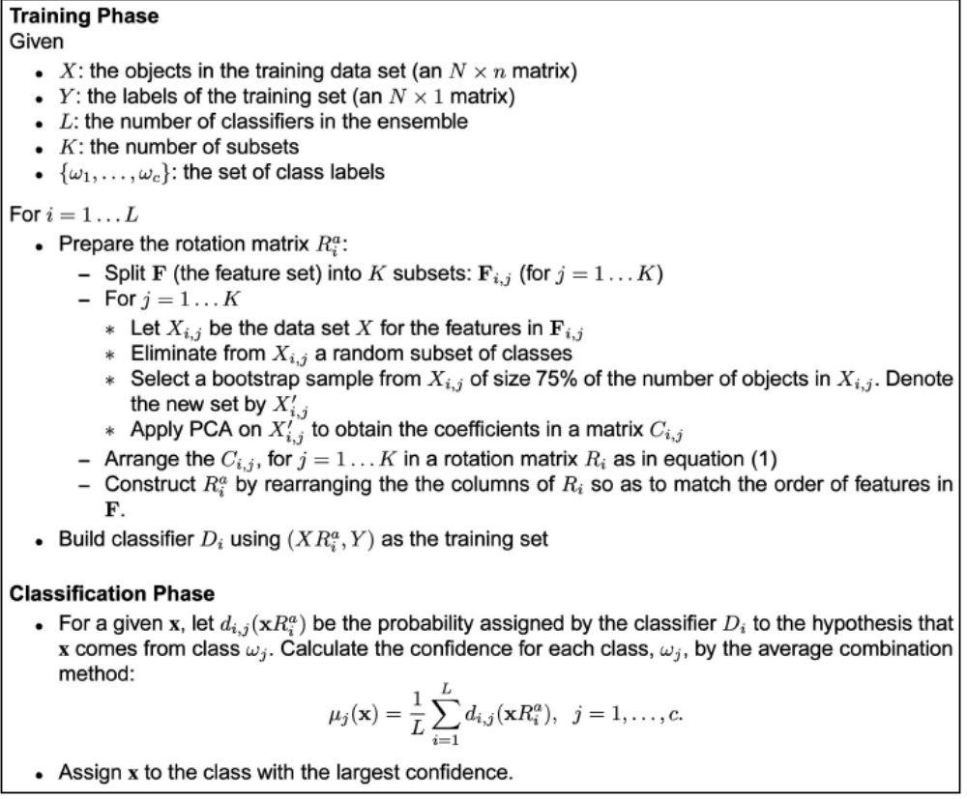
Rotation Forest

Slide 32
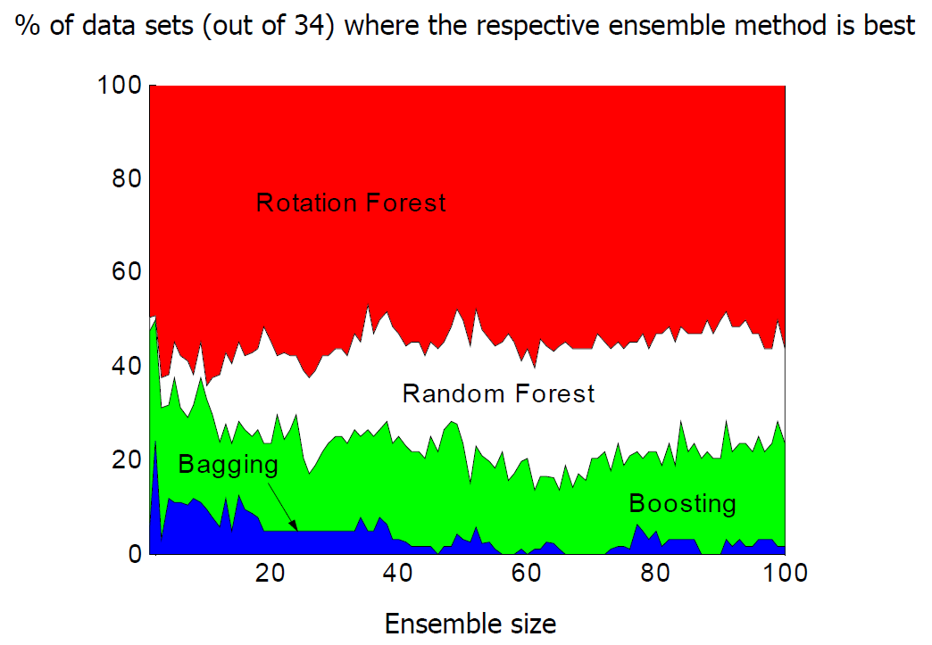

Slide 33
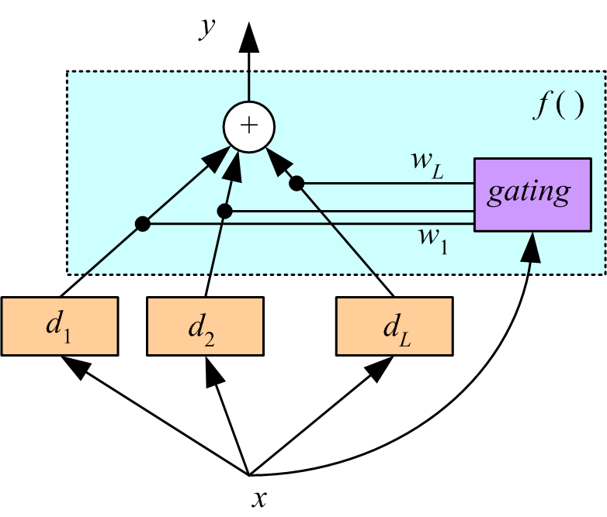
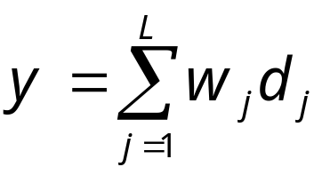
Mixture of Experts
Voting where weights are input-dependent (gating)

Slide 34
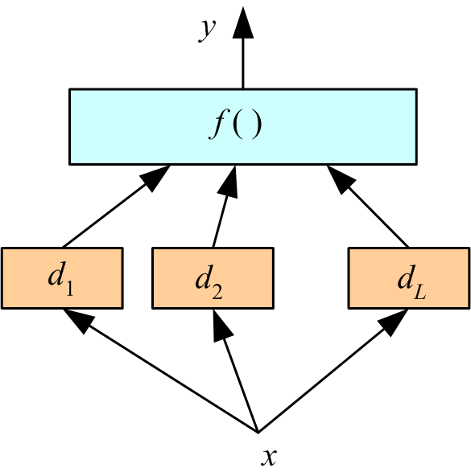
Stacking
Combiner f () is another learner (Wolpert, 1992)

Slide 35
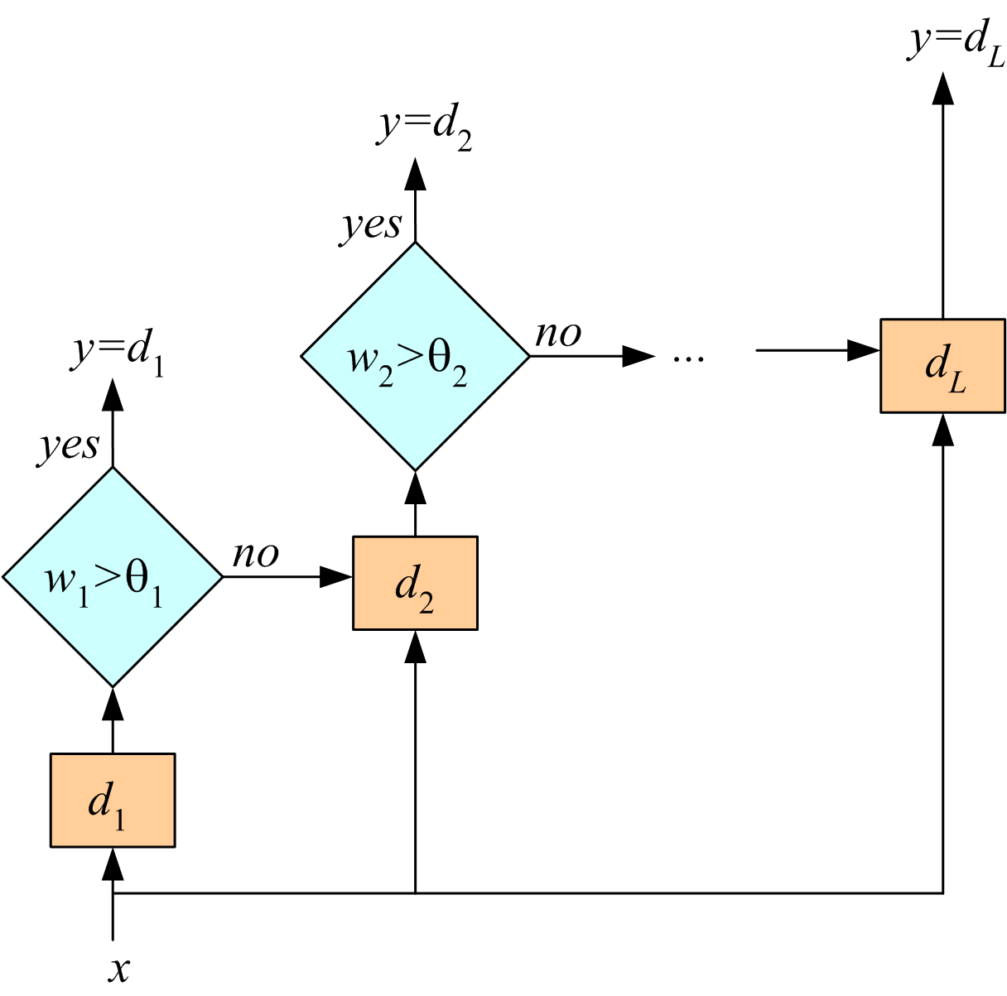
Cascading
Use d_{j} only if preceding ones are not confident
Cascade learners in order of complexity

Slide 36
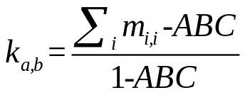

Diversity Measurements
Based on the difference among the outputs(prediction or classification).
An example: Kappa
  Given two classifiers, D_{a} and D_{b}, for a c-class problem, k is defined on a contingency matrix M that is of size c×c. The element m_{i,j} of the matrix stands for the proportion of the data for which D_{a} labels as i-th class and D_{b} labels as j-th class.
  For the ensemble of L classifiers, there are (L-1)×L/2 pairs of classifiers.

Slide 37
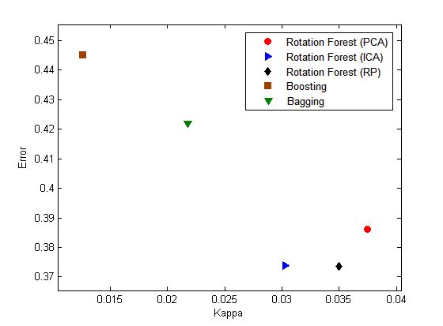
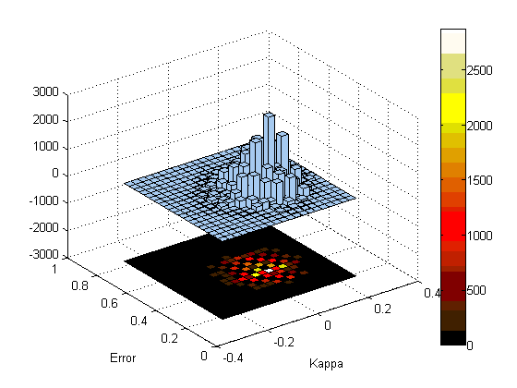
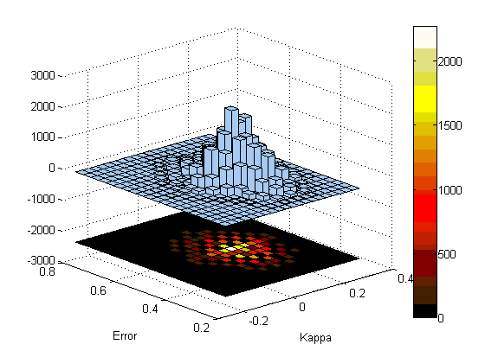
Kappa-error Diagram
A kappa-error diagram, x-axis is the k for the pair, and y-axis is the averaged individual error. E_{a,b}=(E_{a}+E_{b})/2.

Slide 38
Diversity Measurements
Many different measurements, and they are conflicted with the accuracy of base learners.
Higher diversity --> better performance ??
No conclusions can be made.
Currently, diversity measurements can only be used to explain the success of an ensemble, instead of being used to guide the building of an ensemble system.

Slide 39

The Concept of Clustering Ensemble
clustering algorithm 1
partition 1
combine
clustering algorithm 2
unlabeled
data
partition 2
Final
partition
……
……
… …
clustering algorithm N
partition N
Combine multiple partitions of given data into a single partition of better quality

Slide 40
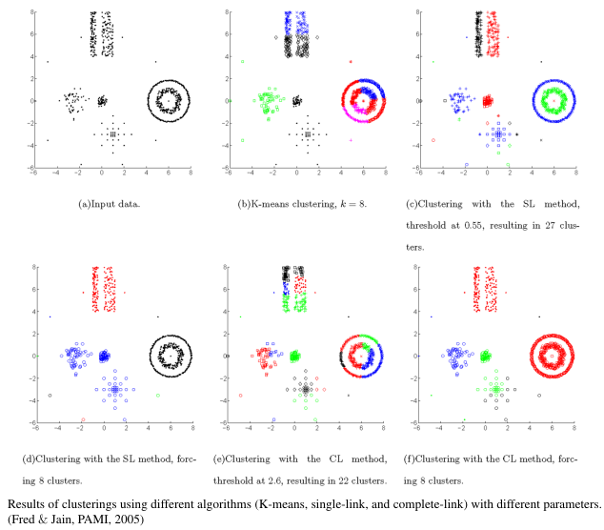
The reason for ensemble clustering
Different clustering algorithms may produce different partitions because they impose different structure on the data; No single clustering algorithm is optimal
Different realizations of the same algorithm may generate different partitions

Slide 41
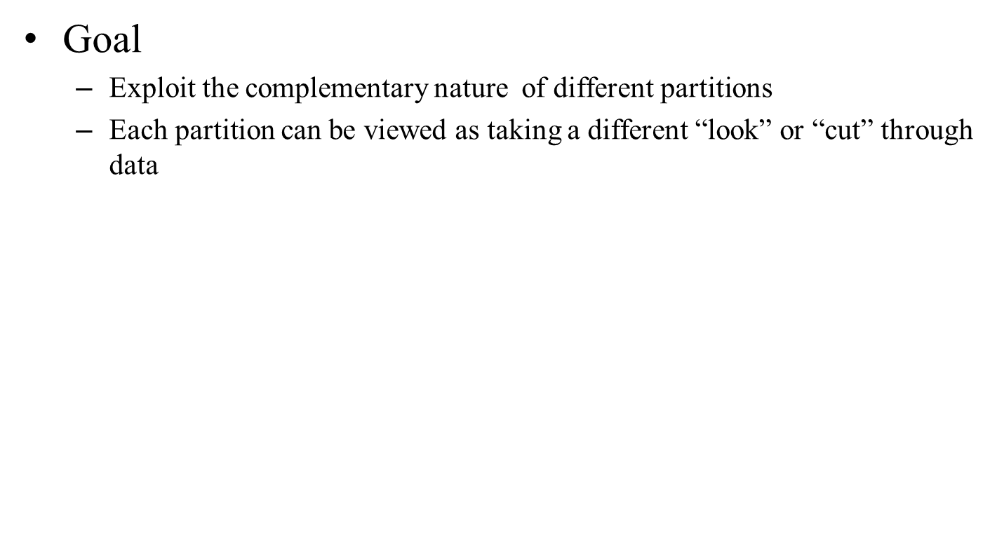
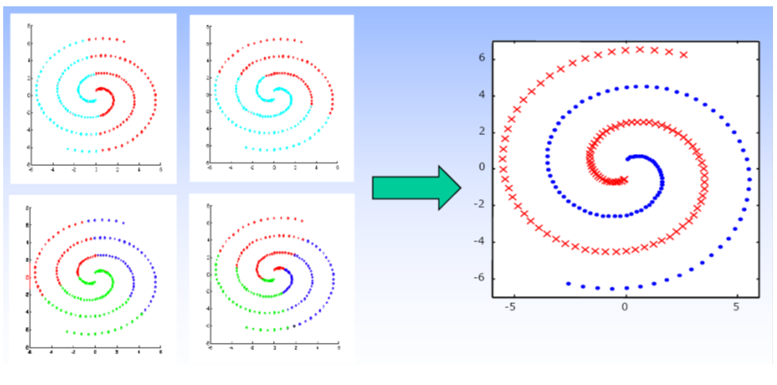
The reason for ensemble clustering

Slide 42
How to ensemble clustering
Produce a clustering ensemble by either
Using different clustering algorithms
  E.g. K-means, Hierarchical Clustering, Fuzzy C-means, Spectral Clustering, Gaussian Mixture Model,….
Running the same algorithm many times with different parameters
  Eg. run K-means algorithm N times using randomly initialized clusters centers; use different dissimilarity measures; use different number of clusters
Using different samples of the data
  E.g. many different bootstrap samples from the givendata
Random projections (feature extraction)
  E.g. project the data onto a random subspace
Feature selection
  E.g. use different subsets of features

Slide 43
How to comine multiple partitions?
According to (Vega-Pons & Ruiz-Shulcloper, 2011), ensemble clustering algorithms can be divided into
Median partition based methods
Object co-occurrence based methods
  Relabeling/voting based methods
  Co-association matrix based methods
  Graph based methods

Slide 44
Median partition based methods
Basic idea: find a partition P that maximizes the similarity between P and all the N partitions in the ensemble: P1, P2, …, PN
Need to define the similarity between two partitions
  Normalized mutual information (Strehl & Ghosh, 2002)
  Utility function (Topchy, Jain, and Punch, 2005)
  Fowlkes-Mallows index (Fowlkes & Mallows, 1983)
P2
P1
S2
P3
S1
S3
P
SN
SN-1
… ….
PN
PN-1

Slide 45
Relabeling/Voting based methods
Basic idea: first find the corresponding cluster labels among multiple partitions, then obtain the consensus partition through a voting process. (Ayad & Kamel, 2007)
Voting
Re-labeling
 | P₁ | P₂ | P₃
v₁ | 1 | 3 | 2
v₂ | 1 | 3 | 2
v₃ | 2 | 1 | 2
v₄ | 2 | 1 | 3
v₅ | 3 | 2 | 1
v₆ | 3 | 2 | 1
 | P₁ | P₂ | P₃
v₁ | 1 | 1 | 1
v₂ | 1 | 1 | 1
v₃ | 2 | 2 | 1
v₄ | 2 | 2 | 2
v₅ | 3 | 3 | 3
v₆ | 3 | 3 | 3
P*
1
1
2
2
3
3
Hungarian
algorithm

Slide 46
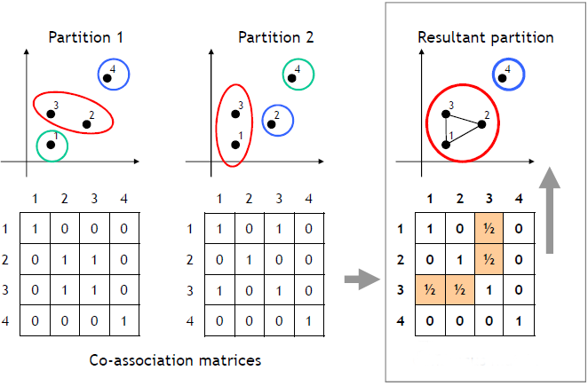
Co-association matrix based methods
Basic idea: first compute a co-association matrix based on multiple data partitions, then apply a similarity-based clustering algorithm (e.g., single link and normalized cut) to the co-association matrix to obtain the final partition of the data.

Slide 47
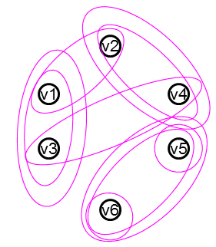
Graph based methods
Basic idea: construct a weighted graph to represent multiple clustering results from the ensemble, then find the optimal partition of data by minimizing the graph cut.
 | P₁ | P₂ | P₃
v₁ | 1 | 1 | 1
v₂ | 1 | 2 | 2
v₃ | 2 | 1 | 1
v₄ | 2 | 2 | 2
v₅ | 3 | 3 | 3
v₆ | 3 | 4 | 3
P*
1
2
1
2
3
3
Graph
clustering

Slide 48
Ensemble Clustering Theory
  Ensemble clustering converges to true clustering as the number of partitions in the ensemble increases (Topchy, Law, Jain, and Fred, ICDM, 2004)
  Bound the error incurred by approximation (Gionis, Mannila, and Tsaparas, TKDD, 2007)
  Bound the error when some partitions in the ensemble are extremely bad (Yi, Yang, Jin, and Jain, ICDM, 2012)
Partition selection
  Adaptive selection (Azimi & Fern, IJCAI, 2009)
  Diversity analysis (Kuncheva & Whitaker, Machine Learning, 2003)

Slide 49
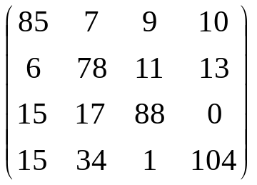
Diversity Measurements
Based on the difference among the outputs(prediction or classification).
An example: Kappa
Given two classifiers, D_{a} and D_{b}, for a c-class problem, k is defined on a contingency matrix M that is of size c×c. The element m_{i,j} of the matrix stands for the proportion of the data for which D_{a} labels as i-th class and D_{b} labels as j-th class.
  ABC(Agree By Chance):
  For the ensemble of L classifiers, there are (L-1)×L/2 pairs of classifiers.
  The smaller, the better.
  0 indicates independence, and negative value is the best.
i
j

